Slide 1
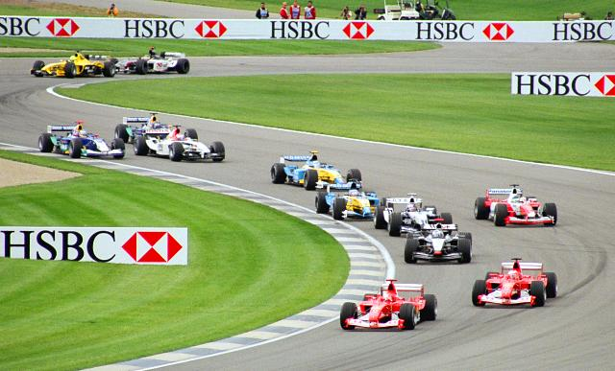
Chapter 2 Acceleration

Slide 2
Average Speed
When you are on a trip, you don’t always drive the same speed. Your average speed is the total distance of the trip divided by the total time of the trip.

Slide 3
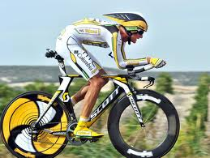

Slide 4
Instantaneous Speed
The instantaneous speed is the speed you have at a specific point of your trip. The speedometer shows instantaneous speed.

Slide 5
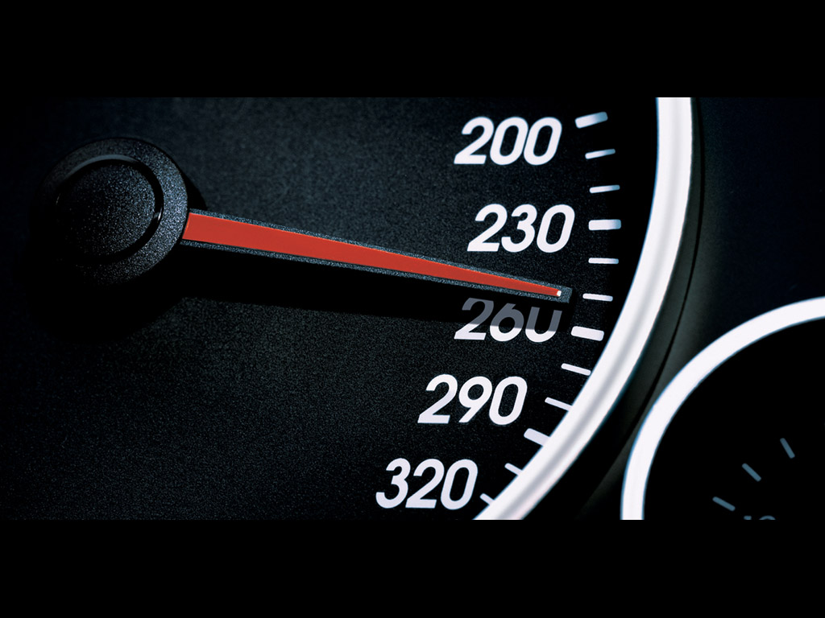

Slide 6
Acceleration You already understand acceleration. If your head moves, you are accelerating. Examples: you hit your brakes, you hit the gas, you turn the car.

Slide 7
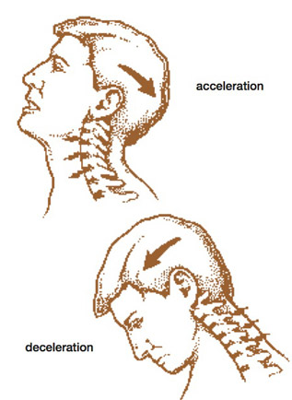

Slide 8
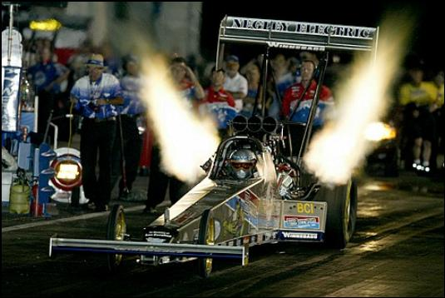
You are only accelerating if your speed is increasing or decreasing.

Slide 9
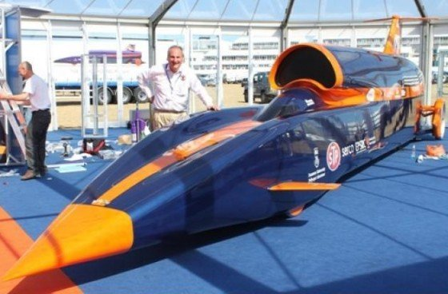
1,000 mph car

Slide 10
Acceleration is the rate of change in the speed of an object.

Slide 11
Negative Acceleration: When you are slowing down.

Slide 13
Positive Acceleration: When you are speeding up.

Slide 15
Remember: Speed is how fast you are moving. Velocity is both speed and direction.

Slide 16
Formula: Final Velocity – Initial Velocity divided by time.

Slide 17
Acceleration = vf – vi ___________________________________________ t

Slide 18
vf = final velocity What is final velocity?

Slide 19
Final Velocity is how fast you are going after acceleration.

Slide 20
What is initial velocity?

Slide 21
Initial Velocity is how fast you are going when you start.

Slide 22
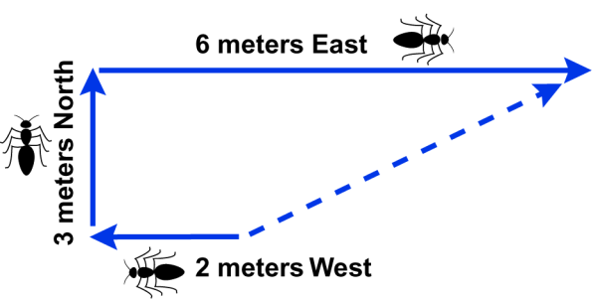
What Distance did the ant walk?

Slide 23
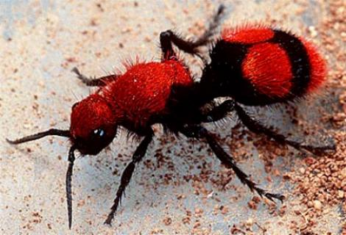
If an ant walked 3 meters due east, and then two meters due west, what is his/her displacement?

Slide 24
If an ant walked 3 meters due east, and then two meters due west, what is his/her displacement? One meter due east Is this answer a speed or a velocity?

Slide 25
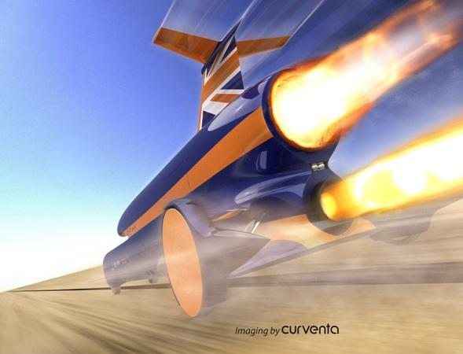
An object requires a force to accelerate!

Slide 26
We have to have units!! m/s/s or m/s²

Slide 27
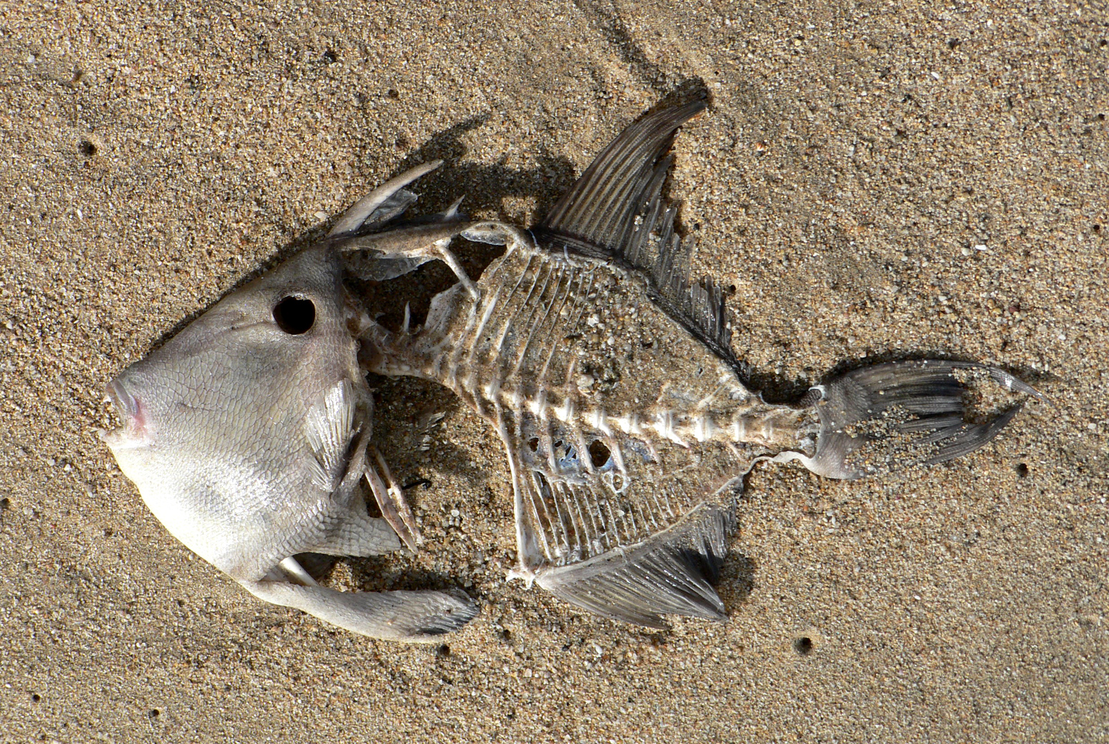
The End

