Slide 1
It’s Friday!
Today’s Warm up!
What do you think will happen if the wings lost their function?
What is an allele?

Slide 2
Agenda
*Predict what a DNA piece would look like if a mutation occurs. [Codon Activity]
* Differentiate between gene mutations and define chromosome mutations.
[Chromosome/Mutation Notes]
*Implement how certain mutations cause certain genetic disorders.
[Genetic Disorder Project Introduction]

Slide 4
Codon Activity

Slide 6
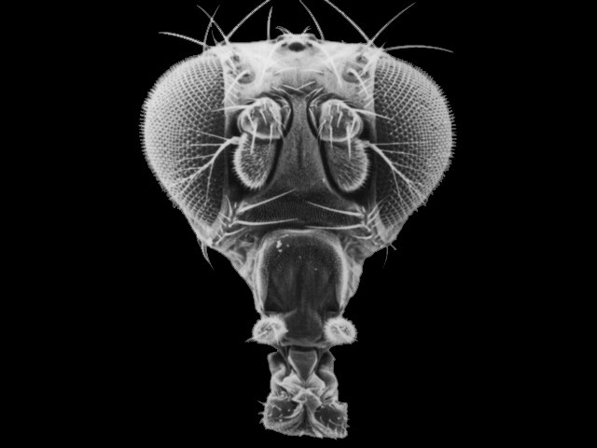
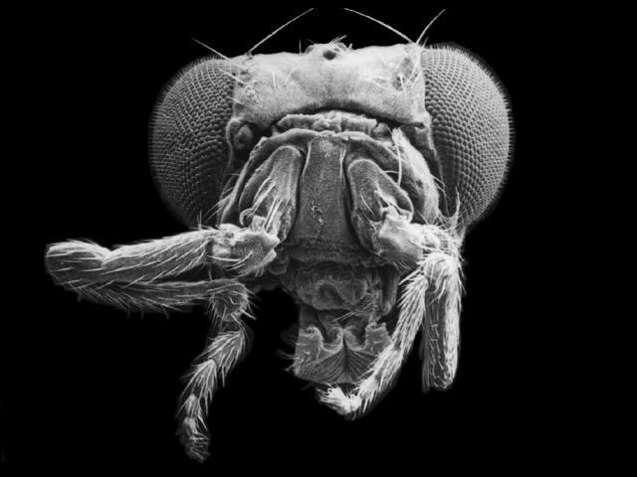
Chromosomal and Gene Mutations
Wild Type Head
Mutant Head (Antennapedia)

Slide 7
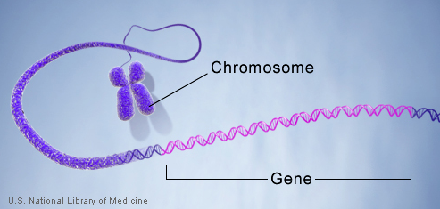
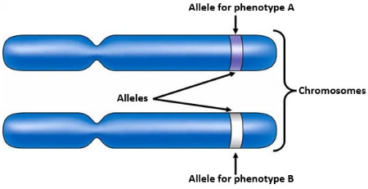
What is a gene?
A section of DNA that is used to make a specific cell product, such as a protein
What is a Chromosome?
A very long chain of DNA that is wrapped with protein and contains multiple genes
Humans have 46 of these!
Humans are called diploid organisms because they have two alleles at each genetic locus, with one allele inherited from each parent.
What is an Allele?
one of two or more alternative forms of a gene that arise by mutation and are found at the same place on a chromosome.

Slide 8
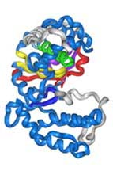
Proteins and Mutations
I. Proteins and Mutations:
A. Some proteins carry out functions within the cells of an organism.
B. Other proteins are transported
outside the cell to complete other
functions.

Slide 9
Proteins and Mutations
C. Still other proteins are used as activators or repressors, turning genes on or off.
D. Therefore, a change in a cell’s proteins could have dramatic effects on the cell’s structure or function.

Slide 10
Proteins and Mutations
E. Changes in the DNA can change the proteins made by the cell.
F. A random change in the sequence of nucleotides in DNA is called a mutation.
G. Some mutations have little or no effect on the organism, others
are harmful and very few are beneficial.

Slide 11
Proteins and Mutations
H. There are two types of mutations:
1. Gene Mutations
2. Chromosomal Mutations

Slide 12
II. Gene Mutations
A.Gene mutations are errors that occur within individual genes in a chromosome.
B.Gene mutations can involve a single nucleotide or they can affect sections of DNA that include many nucleotides.

Slide 13
Gene Mutations
C. The deletion or addition of nucleotides that disrupts codons is called a frameshift mutation.

Slide 14
Gene Mutations
D. Because mRNA is read in codons (three-base sections) during translation, an addition or deletion of nucleotides can alter the sequence of bases, or reading frame, of the genetic message.

Slide 15
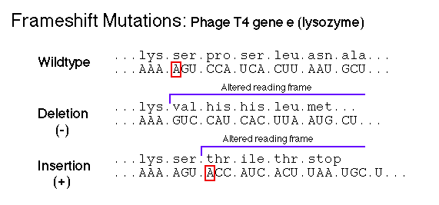
Gene Mutations
E. Analyze the following frameshift mutation:
1. What are the codons in the original reading frame?
2. What are the codons in the shifted reading frame?

Slide 16
Gene Mutations
F. Recall what happens when a strand of mRNA is transcribed from DNA.
G. What might happen if one base is deleted from the DNA?
H. The transcribed mRNA would also be affected.

Slide 17
Gene Mutations
I. Because each mRNA codon corresponds to an amino acid, altering the codons may alter the amino acid sequence.
J. The end result may be an entirely different protein product. Frameshift mutations can have an enormous impact on an organism’s structure and function.

Slide 18
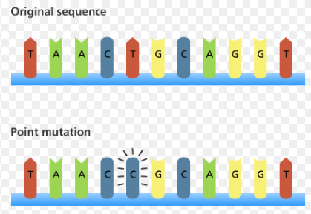
Gene Mutations
K. A change in only one nucleotide is a
point mutation/substitution.
L. Because a point mutation affects a single codon, it tends to be far less disruptive than a frameshift mutation

Slide 19
Gene Mutations
M. Some amino acids are coded for by more than one codon, and substitution may simply change one codon to another codon for the same amino acid.
For example:
1. CUU = Leucine
2. Any change in the third base: CUC, CUA, CUG still codes for the amino acid Leucine.

Slide 20
Gene Mutations
N. About 30% of all substitution mutations produce no changes in proteins.
O. In the remaining 70% of point mutations, changed nucleotides cause a different amino acid to be incorporated into a protein.
P. The resulting protein may function normally or may be defective

Slide 21
Gene Mutations
A third and very common point mutation occurs when a codon in the middle of a gene is changed to a stop codon.
1. For example: UGC = Cysteine but UGA = Stop
2. When genes with this mutation go through protein synthesis, translation is halted before the amino acid chain is completed.

Slide 22
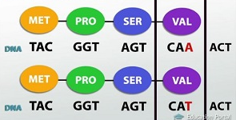
Gene Mutations
Q. Silent -
Resulting in a codon that codes for the same or a different amino acid but without any functional change in the protein product.

Slide 23
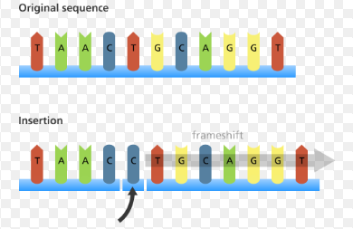
Gene Mutations
R. Insertion
is the addition of one or more nucleotide base pairs into a DNA sequence.

Slide 24
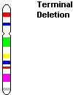
III. Chromosomal Mutations
A. Chromosomal mutations are changes in the structure of a chromosome.

Slide 25
Chromosomal Mutations
Deletion
a part of a chromosome or a sequence of DNA is lost during DNA replication.
Translocation
Takes place when a portion of a chromosome is relocated. The genes from one chromosome can move to another position on the same chromosome; they can become incorporated into a different chromosome.
Inversion
A chromosome breaks at two points - middle piece of the chromosome flips around and gets re-inserted

Slide 26
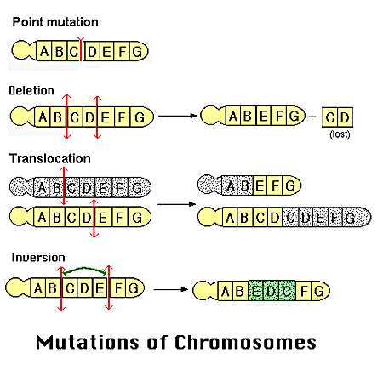

Slide 27
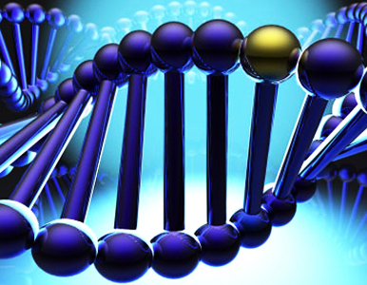
What is a genetic disorder?
A genetic disorder is a genetic problem caused by one or more abnormalities in the genome, especially a condition that is present from birth (congenital). Most genetic disorders are quite rare and affect one person in every several thousands or millions.

Slide 28
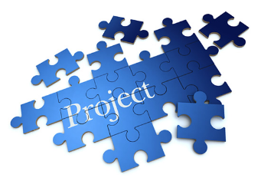
Genetic Disorder
Introduction
Project contains checkpoints - see me to sign off!
Check point #1 DUE AT END OF PERIOD!
Notes:
Pick out of jar.

Slide 29
Exit!
Video link
Are mutations beneficial or harmful?

Slide 30
Have a good weekend!

